Slide 1
Project Presentation for Tools and techniques in data science
Presented by:
Muhammad Junaid Asif
L1S22MSDS0012
Presented To:
Saad Azhar Saeed
01-07-2022

Slide 2
Project presentation
On the topic
Rice grain classification and quality analysis based on k-nn and decision tree
For partial fulfillment of the project assigned for course
Tools and techniques in data science
01-07-2022

Slide 3
Table of contents
1. Abstract
2. About Data Set
3. Project demonstration
4.

Slide 4
Abstract
Outlines the development of system for classification and quality analysis of different kind of rice grains.
Six different type of rice including Jasmine, Basmati, Saila, Arborio and Super colonel.
Data set was compiled by taking 2000 images of each type of rice.
Impurities involved in rice grain was eliminated by data cleaning process.
Correlation of different attributes was find by using HUE Map and BOX PLOT.
After pre-processing the complete data, K-NN and decision tree algorithms will be used for classification and quality analysis of different kind of rice grains.
Accuracy of both techniques will be determined and compared.

Slide 5
About data set – Main Classes
Basmati Type Rice
Saila Type Rice
Super Colonel Type Rice
Jasmine Type Rice
Arborio Type

Slide 6
About data set – Attributes
Area of Rice Grain
Major Axis Length of Rice Grain
Minor Axis Length of Rice Grain
Eccentricity of Rice Grain
Convex Area
Extent
Aspect Ratio
Perimeter
Roundness
Shape Factor 1
Shape Factor 2
Shape Factor 3
Shape Factor 4
Class

Slide 7
About data set – Attributes
Area: The number of pixels within the boundaries of the rice grain.
Major Axis length: The longest line that can be drawn on the rice grain.
Minor Axis length: The shortest line that can be drawn on the rice grain.
Perimeter: The circumference by calculating the distance between pixels around the boundaries of the rice grain.
Eccentricity: It measures how round the ellipse.

Slide 8
Project Demonstration
Importing Data Set from Excel File
data_set = pd.read_excel (r'C:\Users\JUNAID\Desktop\TTDS Project\junaid1.xlsx')
print ("Successfully Imported Data\n", data_set)
2. Counting indices of each attribute
data_set.count()
3. Checking overall Shape of Data Set
data_set.shape

Slide 9
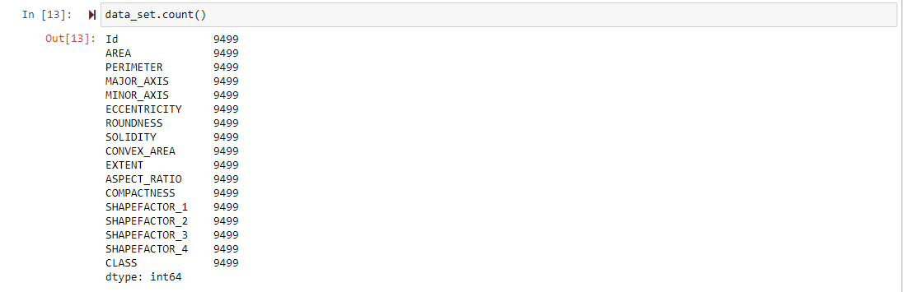
Project Demonstration
2. Counting indices of each attribute
data_set.count()
3. Checking overall Shape of Data Set
data_set.shape

Slide 10
Project Demonstration
3. Overall Shape of Data Set

Slide 11
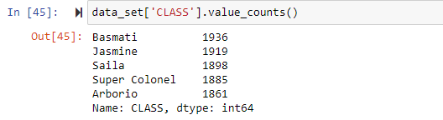
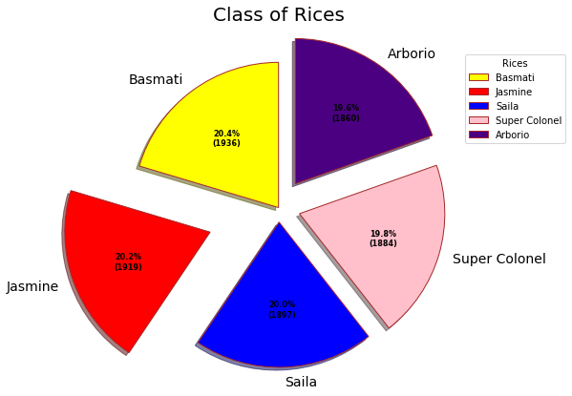
Project Demonstration
4. Overall Data Value Count of Each Class

Slide 12
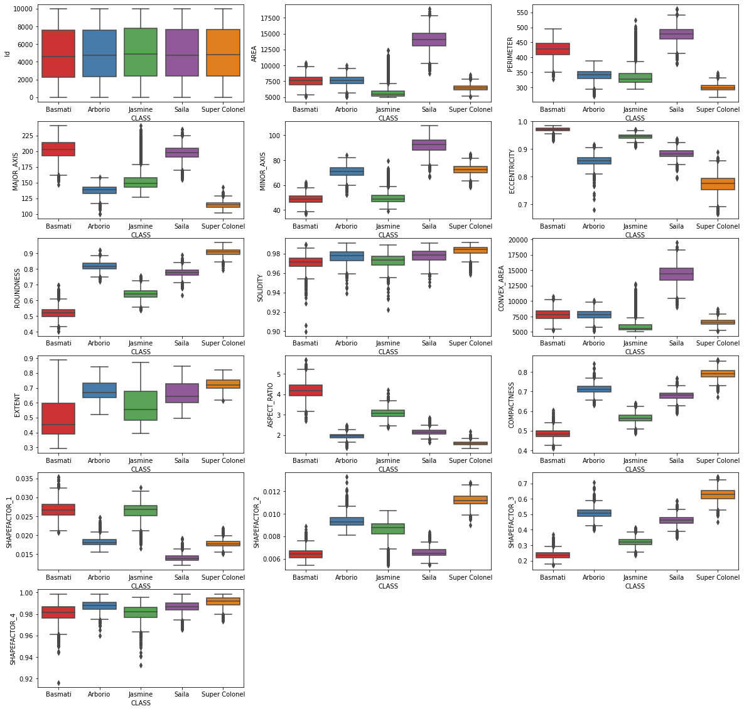
Project Demonstration

Slide 13
Project Demonstration

Slide 14
Project Demonstration

Slide 15
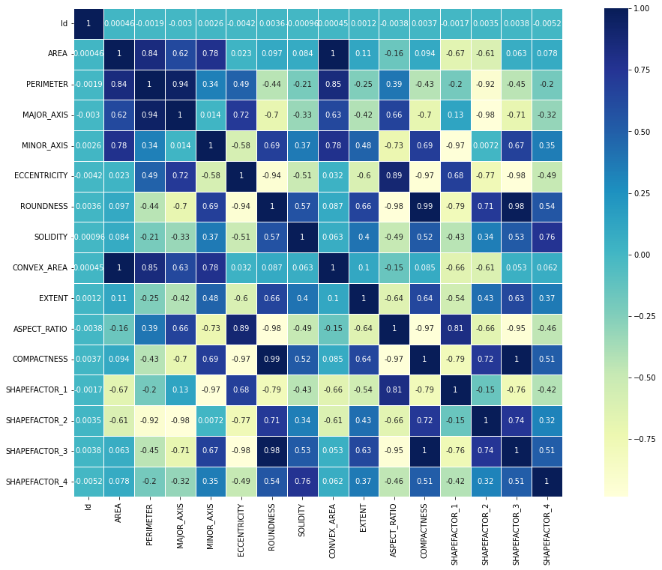
Project Demonstration
On the basis of Hue Map and Box Plot, following of the attributes removed due to high correlation:
Area
Perimeter
Solidity
Convex Area
Extent
Shape Factor 4

Slide 16
Project Demonstration
4. Min-Max Normalization

